Slide 1
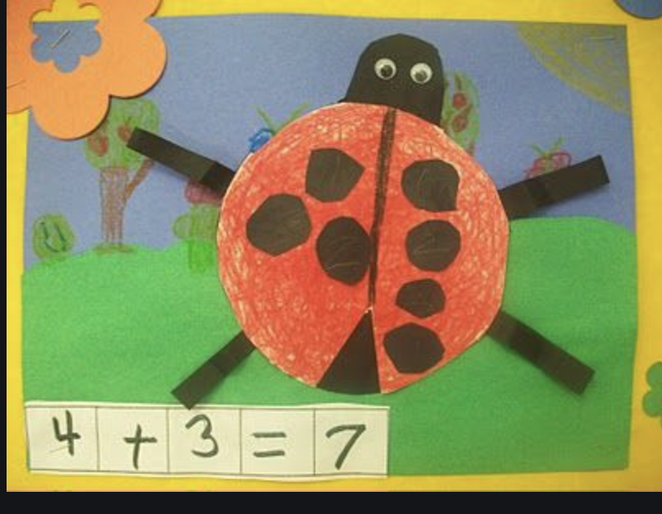
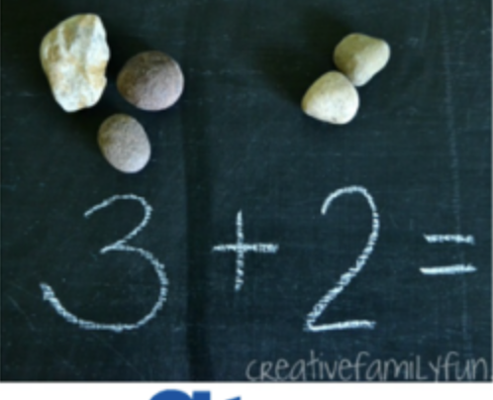
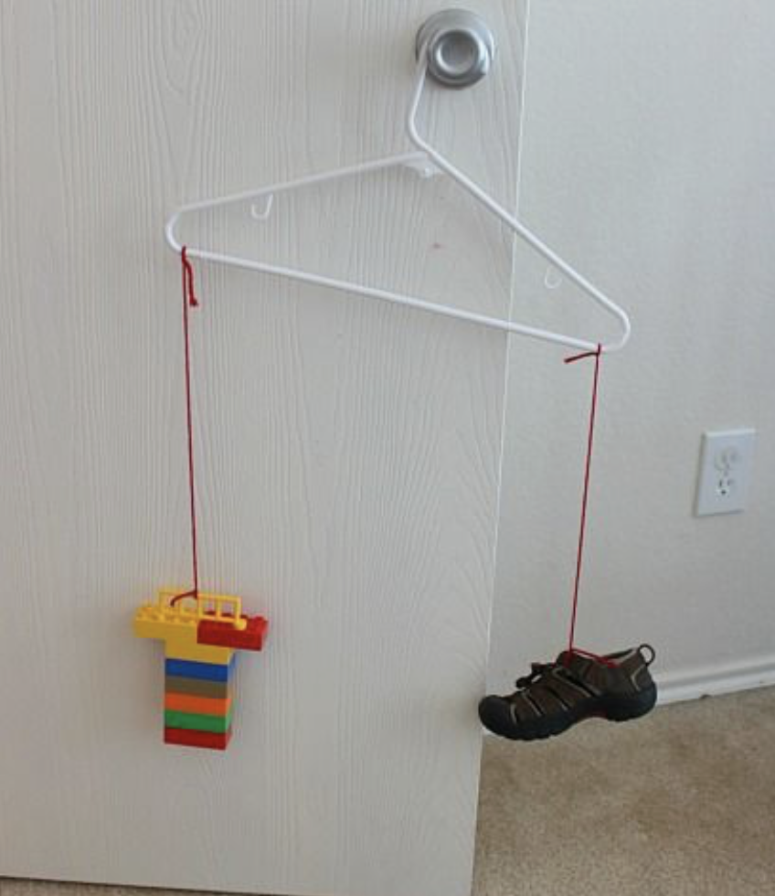
K Home Learning June 1-5, 2020
Here are some activities for you and your family to work on while you’re home.
Counting Count how many of these you have in your house: Windows Doors Chairs Lamps Beds Or anything else you would like | Math Literature Feel free to create a video by recording your story telling based on one of the stories in the links below and share with your teacher or a friend. Or you could video call someone and act out your story or tell your story to them over the phone. Monster Math https://www.youtube.com/watch?v=SusXnpOYqDY Mouse Count https://www.youtube.com/watch?v=uNH6i7239FI | Patterns Using playdough or plasticine, make a pattern caterpillar. Can you make a different one with a different pattern? Try to make an AB, ABC, AAB, ABCD pattern.
Get Creative Create a ladybug with spots on two wings and create a math sentence such as picture below. Draw a background and when done, hang it on your fridge. | Shapes and Sorting Choose a room in your home. Create a list of the shapes you see. ● How many of each shape do you see? ● Sort your shapes. Try to sort 2 different ways. ● Choose 3 shapes and list the number of sides for each shape | Addition And Subtration Collect rocks or something small and make addition sentences on driveway using sidewalk chalk and rocks.
Get Outside Kick the Cup Game - Use cards 1 to 10. Put numbers 1-10 on red Solo cups or something similar and line the cups on your driveway spaced out. Have your child take a card, name the number on it and then kick a ball to knock over the cup. | Measurement How many legos does it weigh? Using a coat hanger as in picture, measure the mass of some items from home with your legos. | Wellness Follow the link to do Arnold the Ant Cosmic Kids Yoga (10 min)i. https://www.youtube.com/watch?v=iWowDC3x0hE

